Slide 1
Asynchronous FIFO

Slide 2
Design specification
Interface
From 1 to 127 buffer size

Slide 3
Alternative approaches

Slide 4
My assumptions

Slide 5
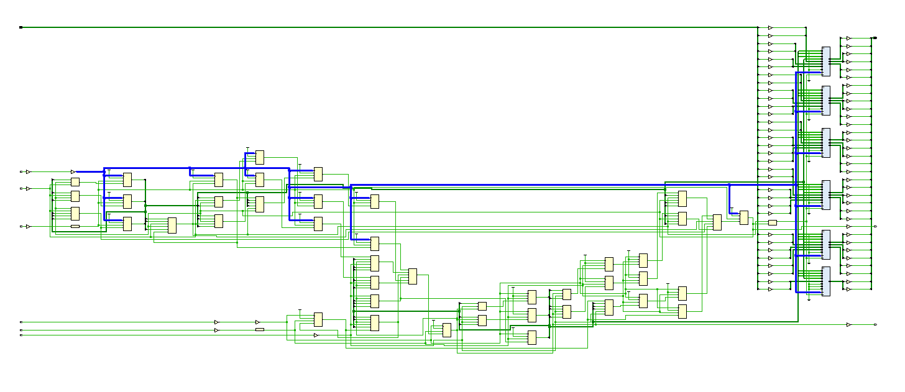
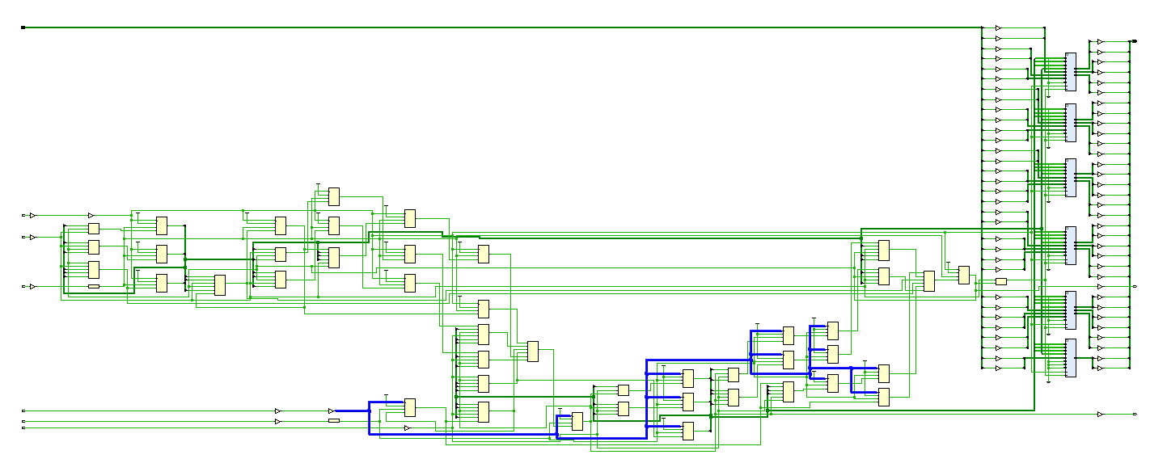

Slide 6
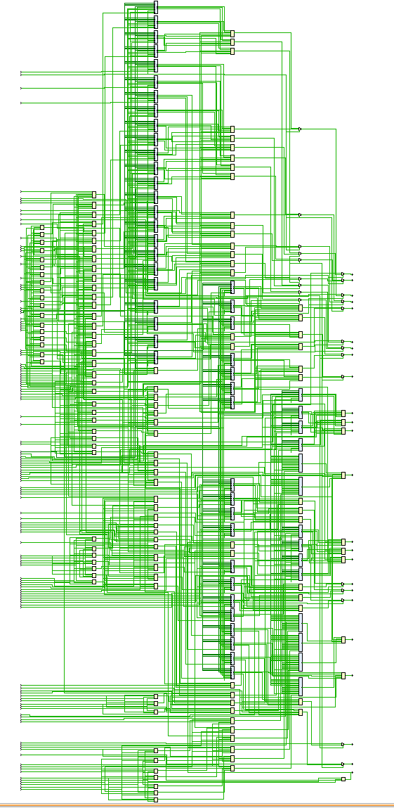
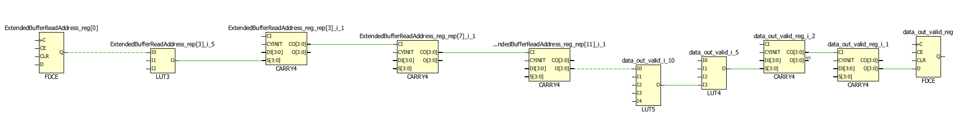
65536

Slide 7
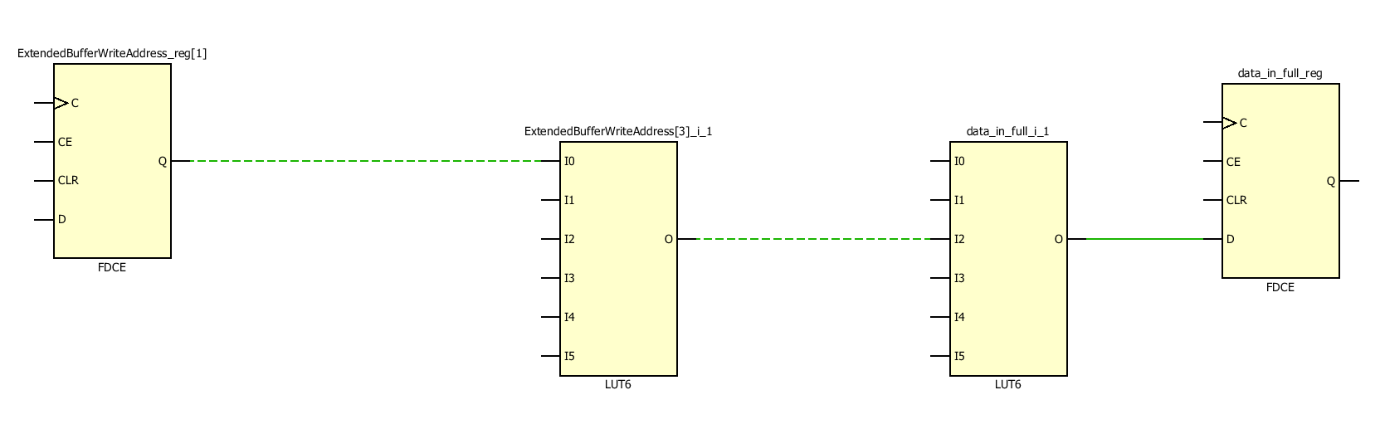
Critical path BUFFER_SIZE 8

Slide 8
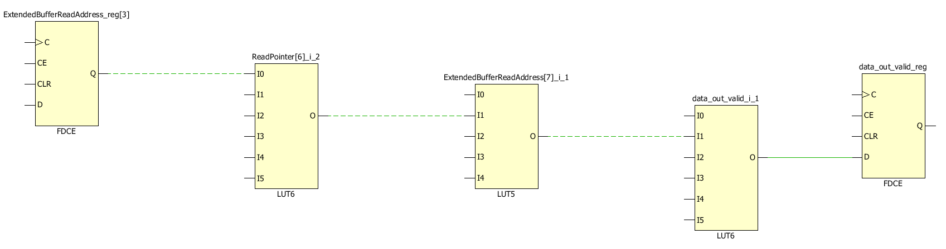
Critical path BUFFER_SIZE 128

